Slide 1

OPERATIONAL & MAINTENANCE MANUAL OF 11kV VACCUM CIRCUIT BREAKER

Slide 2
VACUUM CIRCUIT BREAKER COMPONENTS, FEATURES & BENEFITS

Slide 3
BOM FOR 12kV,1250A (BREAKER PARTS)
Sl.NO | PART NO | DESCRIPTION | DETAIL AND SPECIFICATION | MATERIAL/MODEL | QUANTITY | UNIT
 |  | SHAFT ASSEMBLY
1 | 12BR-001-WAMS | W.A OF MAIN SHAFT | Ø35x512 lg, mm | MS | 1 | NO’S
2 | 12BR-006-BB | BEARING BLOCK | 100x85x20 mm | MS | 2 | NO’S
3 | 12BR-007-MDR | MAIN DRIVE ROD | Ø20x235 mm lg | MS | 1 | NO’S
4 | 12BR-008-PNMS | SS PIN FOR DRIVE ROD WITH MAINSHAFT | Ø12x52 mm lg | SS | 6 | NO’S
5 | 12BR-009-A-REB | ROD END BEARING A | Ø10 mm | 10 POS MALE | 3 | NO’S
6 | 12BR-009-B-REB | ROD END BEARING B | Ø12 mm | 12 POS FEMALE | 2 | NO’S
7 | 12BR-009-01-BTD | BEARING SPEC. | 62x25 mm | 6305ZZ | 2 | NO’S

Slide 4
 |  | POLE ASSEMBLY
8 | 12BR-011-EHI | HOUSING FOR INTERRUPTER | 620x150 mm | EPOXY | 3 | NO’S
9 | 12BR-012-VI-B14 | VACUUM INTERRUPTER | Ø110x227 mm 2000A | B14 | 3 | NO’S
10 | 12BR-013-TT-800A | TOP TERMINAL(630-800A) | 50x10x275 lg mm | COPPER | 3 | NO’S
11 | 12BR-014-TT-1250A | TOP TERMINAL(1250A) | 60x12x275 lg mm | COPPER | 3 | NO’S
12 | 12BR-015-ISOC-800A | ISOLATING CONTACT | 120x50x6 mm | COPPER | 12 | NO’S
13 | 12BR-016-A-PP | PRESSURE PLATE 1MM | 20x2x9 mm | SPRING STEEL | 24 | NO’S
14 | 12BR-016-B-PP | PRESSURE PLATE 2MM | 20x1x95 mm | SPRING STEEL | 24 | NO’S
15 | 12BR-017-A-STUD | STUD FOR ISOLATING CONTACT M6 | M6x65mm | STEEL | 12 | NO’S
16 | 12BR-017-B-STUD | STUD FOR ISOLATING CONTACT M8 | M8x65 mm | MS | 12 | NO’S
17 | 12BR-018-SAS | SELF ALIGN SPRING | Ø9 mm | MS | 12 | NO’S

Slide 5
18 | 12BR-019-MCB(800A) | MOVING CONTACT BLOCK (800A) | 47x60x20 mm | ELY.Cu/Br | 3 | NO’S
19 | 12BR-019-MCB(1250A) | MOVING CONTACT BLOCK (1250A) | 47x60x20 mm | ELY.Cu/Br | 3 | NO’S
20 | 12BR-020-BT(1250A) | BOTTOM TERMINAL(1250A) | 60x12x275 mm | ELY.Cu/Br | 3 | NO’S
21 | 12BR-021-BT(800A) | BOTTOM TERMINAL(800A) | 50x10x275 mm | ELY.Cu/Br | 3 | NO’S
22 | 12BR-022-F(1250A) | COPPER FLEXIBLE(1250A) | 60x230x12 mm | COPPER | 3 | NO’S
23 | 12BR-022-F(800A) | COPPER FLEXIBLE(800A) | 50x190x6 mm | COPPER | 3 | NO’S
24 | 12BR-023-DRFP | DRIVE ROD FOR POLE | Ø16x208 lg mm | MS | 3 | NO’S
25 | 12BR-024-IFDR | INSULATOR FOR DRIVE ROD | Ø43.5x150 mm | EPOXY | 3 | NO’S
 |  | SPRING ASSEMBLY (CLOSE)
26 | 12BR-025-OCS | OUTER CLOSING SPRING | Ø6x260 lg mm | SPRING STEEL | 1 | NO’S
27 | 12BR-026-LWFCS | LOCATING WASHER FOR CLOSING SPRING | Ø52x10 lg mm | MS | 2 | NO’S

Slide 6
28 | 12BR-029-WAGR | WA OF GUIDE ROD | 355x50x20 mm | MS | 1 | NO’S
29 | 12BR-030-WASBCS | WA OF SWIVEL BLOCK FOR CLOSING SPRING | 98x40x40 mm | MS | 1 | NO’S
 |  | SPRING ASSEMBLY (OPEN)
30 | 12BR-031-PN-REB | PIN FOR ROD END BEARING | Ø10x52 lg mm | SS | 3 | NO’S
31 | 12BR-031-1-PNBC | SS PIN FOR BEL CRANK | Ø12x66 lg mm | SS | 3 | NO’S
32 | 12BR-032-SWBC | SWIVEL BLOCK FOR BEL CRANK | Ø12x58x30 lg mm | MS | 3 | NO’S
33 | 12BR-033-LWCS | LOCATING WASHER FOR CONTACT SPRING | Ø50x15 lg mm | MS | 6 | NO’S
34 | 12BR-034-STUD-CS | STUD FOR CONTACT SPRING | Ø12x235 lg mm | MS | 3 | NO’S
35 | 12BR-035-CS(I) | CONTACT SPRING (INNER) | Ø4x122 mm lg | SPRING STEEL | 3 | NO’S
36 | 12BR-036-HS(O) | HOLD OPEN SPRING(OUTER) | Ø4.5x250 lg mm | SPRING STEEL | 1 | NO’S
37 | 12BR-037-H(I) | HOLD OPEN SPRING(INNER) | Ø20x250 lg mm | SPRING STEEL | 1 | NO’S

Slide 7
38 | 12BR-038-LWOS | LOCATING WASHER FOR HOLD OPEN SPRING | Ø35x10 mm | MS | 2 | NO’S
39 | 12BR-039-SFBC | SPACER FOR BELL CRANK | Ø18x25 lg mm | MS | 3 | NO’S
40 | 12BR-040-B | BELL CRANK | 84x74x6 mm | MS | 6 | NO’S
41 | 12BR-041-SFOS | STUD FOR OPEN SPRING | Ø12x290 mm | MS | 1 | NO’S
42 | 12BR-042-SBFHO | SWIVEL BLOCK ASSEMBLY FOR HOLD OPEN SPRING | 100x60x6 mm | MS | 1 | NO’S
43 | 12BR-043-AB | ADOPTER BLOCK FOR SPRING GUIDE | Ø20x40 lg mm | MS | 3 | NO’S
44 | 12BR-044-CS(O) | CONTACT SPRING OUTER | Ø6x112 lg mm | SPRING STEEL | 3 | NO’S
 |  | DASHPOT ASSEMBLY
45 | 12BR-045-PISR | PISTON RING | Ø52.25 lg mm | CAST IRON | 1 | NO’S
46 | 12BR-046-DP | DASH POT | Ø60x76 lg mm | ALUMINIUM | 1 | NO’S
47 | 12BR-047-WAPIS | WA OF PISTON DASHPOT | Ø49.5x175 lg mm | MS | 1 | NO’S
48 | 12BR-050-SWDP | WA SWIVEL BLOCK FOR DASHPOT | 90x85x10 mm | MS | 1 | NO’S

Slide 8
 |  | BREAKER ACCESSORIES
49 | 12BR-054-CH | CHARGING HANDLE | Ø16x390 lg mm | MS | 1 | NO’S
50 | 12BR-054-DH | DOOR HANDLE | Ø11x141 mm | MS | 2 | NO’S
51 | 12BR-055-ASL | AUXILIARY SWITCH LEVER | 24x73x12 mm | NYLON | 1 | NO’S
 |  | TRIPPING INTERLOCK ASSEMBLY
52 | 12BR-056-TIR | TRIPPING INTERLOCK ROD | 12x12 SQx855 mm | MS | 1 | NO’S
53 | 12BR-058-WFTI | WHEEL FOR TRIPPING INTERLOCK | Ø45x25 mm | NYLON | 2 | NO’S
54 | 12BR-059-PNFTI | SS PIN FOR TRIPPING INTERLOCK | 10x52 lg mm | SS | 1 | NO’S
 |  | SCREWROD ASSEMBLY
55 | 12BR-060-WARH | WA OF RACK IN/OUT HANDLE | Ø12x900 mm | MS | 1 | NO’S
56 | 12BR-060-01-SR | SCREWROD | 360x Ø30 mm | MS | 1 | NO’S
57 | 12BR-061-NB | NUT BLOCK FOR SCREWROD | 76x76x16mm | MS | 1 | NO’S

Slide 9
58 | 12BR-062-HB | HINGE BLOCK FOR SCREWROD | 76x76x16 mm | MS | 1 | NO’S
 |  | SHUTTER ASSEMBLY
59 | 12BR-063-SH | SMC SHUTTER | 684x140x4 mm | FRP | 2 | NO’S
60 | 12BR-064-SSR | SHUTTER SQUARE ROD | 12x12SQx1020 mm | MS | 2 | NO’S
61 | 12BR-065-RLFS | RISING LEVER FOR SHUTTER | 670x25x6 mm | MS | 2 | NO’S
62 | 12BR-073-RO-SH | WHEEL FOR SHUTTER | Ø65x25 mm | NYLON | 2 | NO’S
 |  | WHEEL ASSEMBLY
 | 12BR-075-TW | TRUCK WHEEL | Ø84x25 lg mm | NYLON | 4 | NO’S
63 | 12BR-076-PNFTW | SS PIN FOR TRUCK WHEEL | Ø12x62 lg mm | SS | 4 | NO’S
 |  | COIL ASSEMBLY
64 | 12BR-077-CC | CLOSING COIL | 110 V DC, 285W, 37Ω | COPPER COIL | 1 | NO’S
65 | 12BR-078-TC | TRIP COIL | 110 V DC, 285W, 37Ω | COPPER COIL | 1 | NO’S

Slide 10
 |  | PUSH BUTTON ASSEMBLY
66 | 12BR-079-PLB | PLUNGER FOR L BRACKET | Ø20X65 mm | MS | 2 | NO’S
67 | 12BR-085-CLB | CLOSING FOR L BRACKET | 100x500x5 mm | MS | 1 | NO’S
 |  | ELECTRICAL ITEMS
68 | 12BR-087-LS | LIMIT SWITCH FOR SPRING CHARGE MOTOR | 2NO+2NC | JO2 SILR | 1 | NO’S
69 | 12BR-088-AS | AUXILIARY SWITCH | 8NO+8NC | ..... | 1 | NO’S
70 | 12BR-089-SP.M | SPRING CHARGE MOTOR | 230VAC, 150w | SG103S12 | 1 | NO’S
71 | 12BR-090-W | WIRES | 1.5 SQ.mm | COPPER | 100 | NO’S
72 | 12BR-091-LU | LUGS | 1.5 SQ.mm | ALUMINIUM | 90 | NO’S
73 | 12BR-092-BNW-1 | BOLT NUTS WITH WASHERS-1 | M08x25 mm | MS | 10 | NO’S
74 | 12BR-093-BNW-2 | BOLT NUTS WITH WASHERS-2 | M10x30 mm | MS | 15 | NO’S
75 | 12BR-094-P&S | PLUG & SOCKET | 24 PIN | PLASTIC | 1 | NO’S

Slide 11
76 | 12BR-095-TB | TERMINAL BLOCK | CTS 6 | PLASTIC | 10 | NO’S
77 | 12BR-096-TWR | TRUFF WITH RAIL | 25x40 | MS | MTR,200C | NO’S
78 | 12BR-097-SCM | SPRING CHARGE COMPONENTS | MS-2mm | ..... | 1 | NO’S
79 | 12BR-098-GM | GROUP MARKER | GMH6 | PLASTIC | 1 | NO’S
80 | 12BR-099-EP | END PLATE | EP6/10U | PLASTIC | 1 | NO’S
81 | 12BR-100-EC | END CLAMP | EA702 | PLASTIC | 2 | NO’S
82 | 12BR-101-CT | COUNTER | RS5 STROKE COUNTER | FRP | 1 | NO’S
 |  | HARDWARES
83 | 12BR-102-NLN-1 | NYLON LOCK NUT -1 | M6 | SS | 24 | NO’S
84 | 12BR-103-NLN-1 | NYLON LOCK NUT -2 | M8 | SS | 26 | NO’S
85 | 12BR-104-WS-1 | WASHER -1 | M6 | SS | 24 | NO’S
86 | 12BR-105-WS-1 | WASHER -2 | M8 | MS | 26 | NO’S

Slide 12
87 | 12BR-107-HN-2 | HALF NUT -2 | M12 | MS | 12 | NO’S
88 | 12BR-108-HEN | HEX NUT | M16 | MS | 2 | NO’S
89 | 12BR-110-BW-1 | BRASS WASHER -1 | M12X1 mm | MS | 15 | NO’S
90 | 12BR-111-BW-2 | BRASS WASHER -2 | M12X0.5 mm | MS | 15 | NO’S
91 | 12BR-112-HC | HELICOIL | M10X1(800A) | MS | 6 | NO’S
92 | 12BR-114-AB | ALLEN BOLT | M12X45 mm | MS | 3 | NO’S
93 | 12BR-115-HB-1 | HEX BOLT -1 | M10X55 mm | MS | 22 | NO’S
94 | 12BR-117-HB-3 | HEX BOLT -3 | M10X30 mm | MS | 10 | NO’S
95 | 12BR-119-HB-A | HEX BOLT -A | M8X40 mm | MS | 2 | NO’S
96 | 12BR-121-HB-C | HEX BOLT –C | M8X25 mm | MS | 65 | NO’S
97 | 12BR-122-HB-D | HEX BOLT –D | M6X25 mm | MS | 10 | NO’S
98 | 12BR-123-CHS | C.H.S | 6X15 mm | MS | 10 | NO’S

Slide 13
99 | 12BR-124-MECH | MECHANISM (WITH CLOSE & TRIP LATCH ASSEMBLY, WITHOUT COIL AND SPRING) | 250X280 mm | MS | 1 | NO’S
100 |  | ALUMINIUM PUSH BUTTON WITH M.S WELDED BRACKET |  |  | 1 | Set
101 |  | M.S PUSH BUTTON WITH M.S HOLLOW BUSH |  |  | 1 | Set
 |  | OLD BREAKER COMPONENTS WHICH ARE NOT USED
102 | 12BR-053-SP-A | SUPPORT PILLAR FOR BREAKER –A | Ø16X346 lg mm | MS | 1 | NO’S
103 | 12BR-053-SP-B | SUPPORT PILLAR FOR BREAKER –B | Ø16X352 lg mm | MS | 1 | NO’S
104 | 12BR-069-SP-SH | SHUTTER BUSH FOR SHUTTER | Ø12x15 lg mm | MS | 2 | NO’S
105 | 12BR-109-SP | ZINC PLATED SPLIT PIN 2.5X25 | 2.5x25 mm | MS | 50 | NO’S
106 | 12BR-116-HB-2 | HEX BOLT -2 | M10x45 mm | MS | 20 | NO’S
107 | 12BR-118-AB | ALLEN BOLT | M8x75 mm | MS | 6 | NO’S
108 | 12BR-120-HB-B | HEX BOLT -B | M8x30 mm | MS | 14 | NO’S

Slide 14
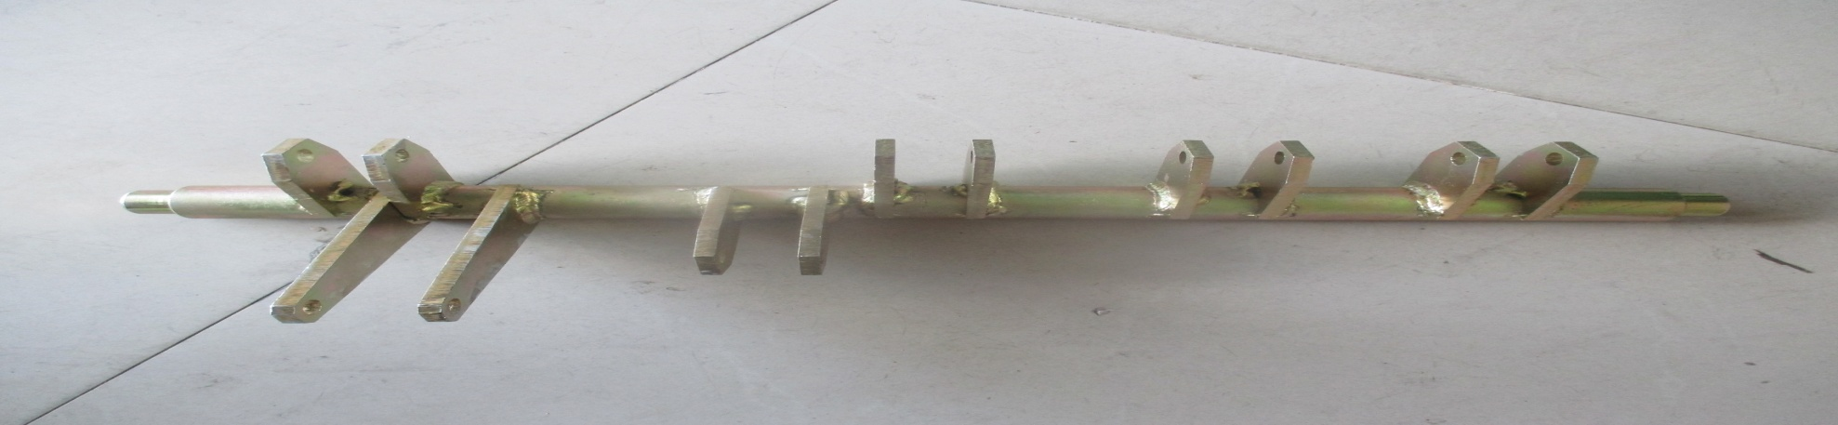
WELDING ASSEMBLY OF MAIN SHAFT
Main shaft is the shaft used to convert x-axis force into y-axis for switching ON & OFF the Vacuum Circuit Breaker by using welded attachments to the shaft at a particular angle.
It is made up of Mild steel which is having high torsion and shear strength . Hence it does not twist easily.
It is mounted on the bearing block holding bearing spec.

Slide 15
PROPERTIES | MILD STEEL | STAINLESS STEEL
CORROSION RESISTANCE | LOW | HIGH
MALLEABILITY | MEDIUM | LOW
HARDNESS | 120HB | 200HB
STRENGTH | 247MPa | 215 MPa
DURABILITY | LOW | HIGH
WEIGHT | HIGH | LOW
WEAR RESISTANCE | MEDIUM | LOW

Slide 16
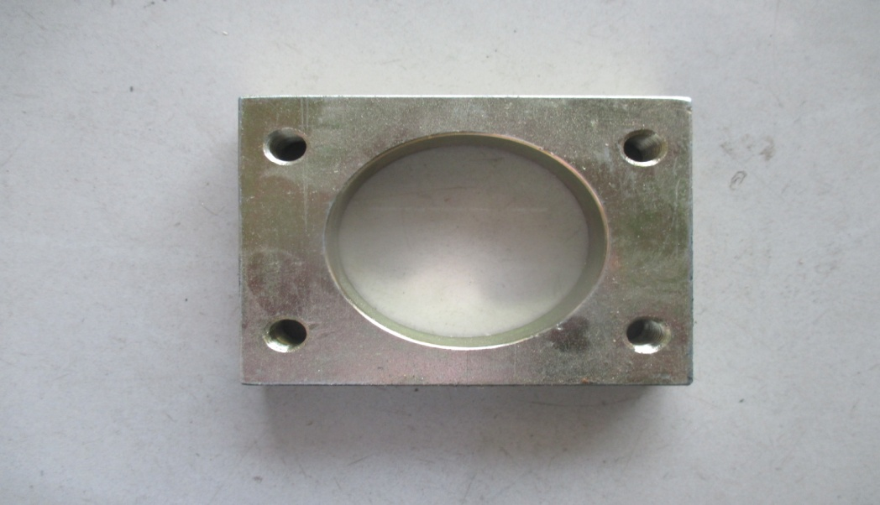
BEARING BLOCK
Bearing block is used to hold the bearing.
It is made up of Mild Steel which has high toughness and ductility makes to withstand more weight.

Slide 17
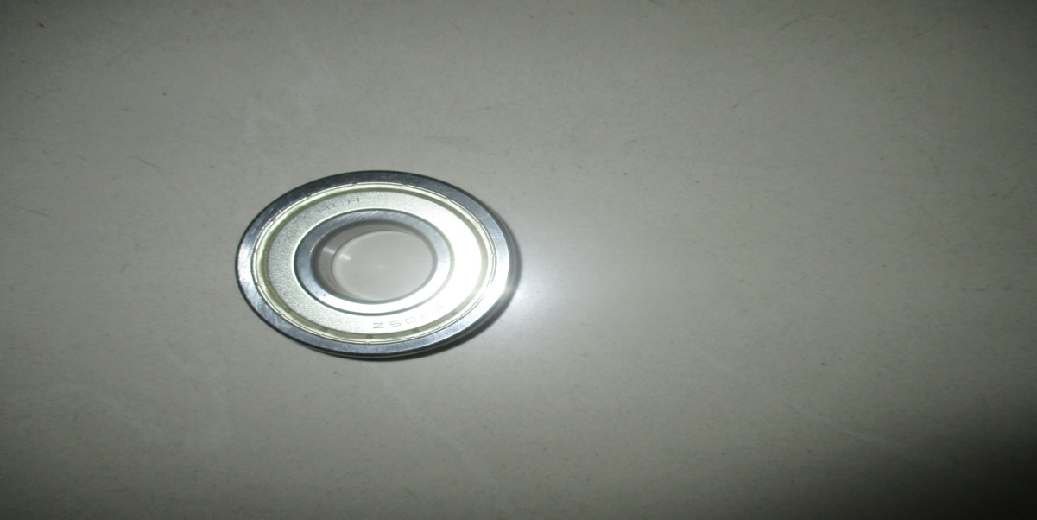
BEARING SPEC
The Deep groove Ball bearing (for high loads) allows friction-free movement and rotation of the main shaft held by bearing block.
It has the ability to adapt to many different functions or activities and overall performance.
It is made up of 52100 bearing steel, a high carbon, chromium contained alloy steel having high wear resistance, and anti-friction properties.

Slide 18
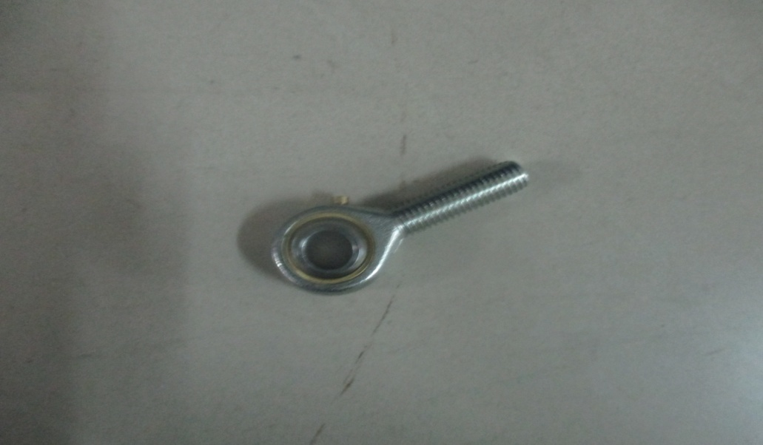
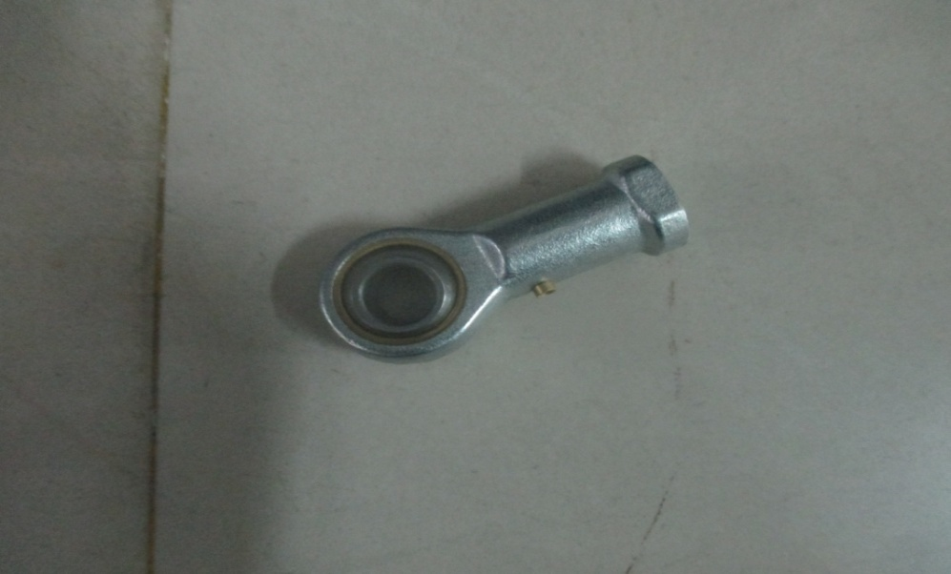
ROD END BEARING A&B
Rod end bearing A
Rod end bearing B
POS series male & female Rod End Bearing or heim joint is used where shaft may be misaligned or dynamic.
It is made up of heat treated Medium carbon steel/Bearing steel has lower coefficient of friction and high strength.
Hence wear is reduced greatly.

Slide 19
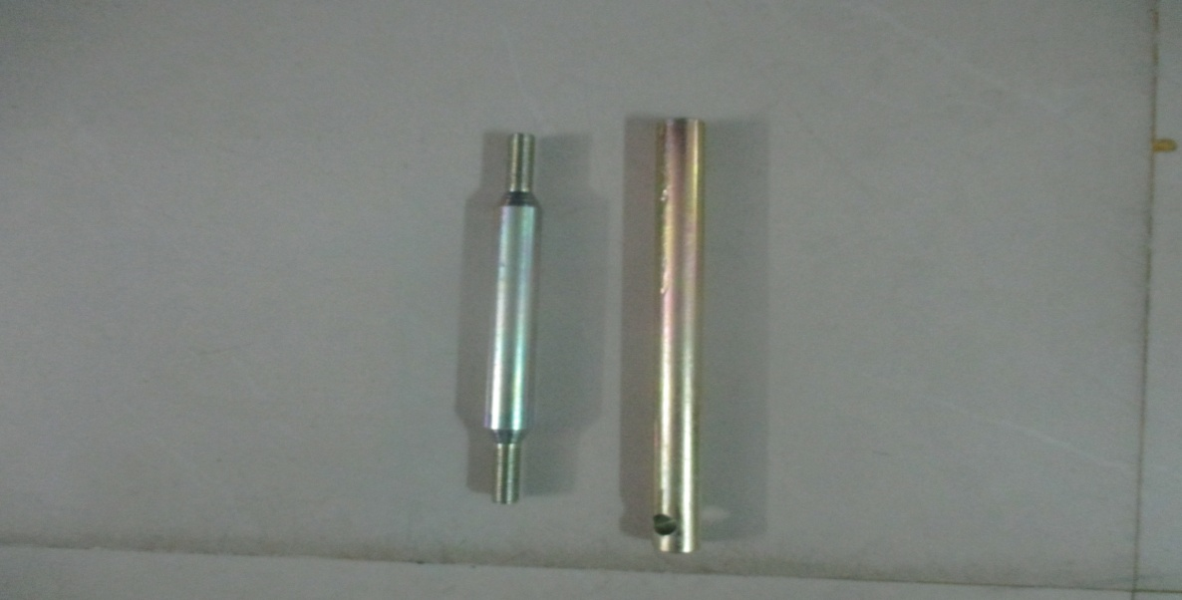
MAIN DRIVE ROD
Main drive rod is used to drive the main drive shaft while switching ON & OFF the Vacuum Circuit Breaker
It is made up of Mild steel because it has great strength to withstand sudden impact load.
The middle part is larger to increase the hardness and strength while the upper part is small in diameter to hold it.

Slide 20
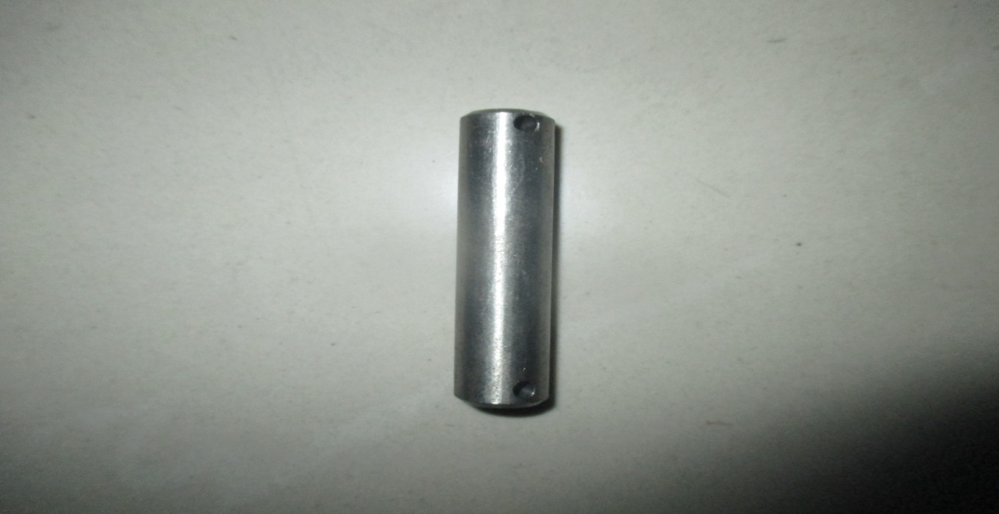
SS PIN FOR DRIVE ROD
SS Pin is used to connect drive rod with main shaft.
It made up of Stainless Steel (SS) which has high ductility hence wear is reduced.
Since Main Drive Rod & Main Drive shaft is same material, SS pin is selected to eliminate galling (i.e cold welding due to friction)

Slide 21
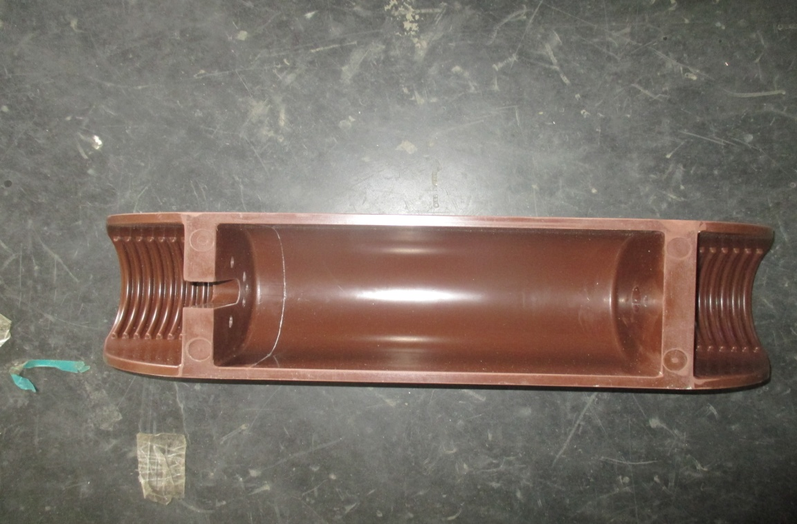
HOUSING FOR INTERRUPTER
Interrupter housing acts as insulator and also for holding the Vacuum Interrupter.
It is made up of Epoxy which is known for its durability, strength, functionality and resistance to corrosion & abrasion.
It has high heat resisting and electrical insulating properties.

Slide 22
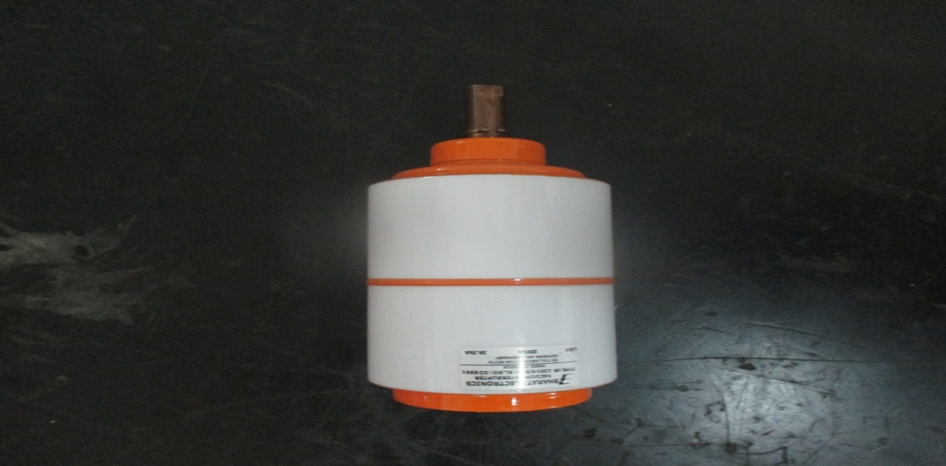
VACUUM INTERUPTER(B14)
Vacuum interrupter is a device which interrupts the electrical contact and quenches the arc by a vacuum medium.
Vacuum interrupters are used in power transmission systems, power generation unit, and power-distribution systems for industrial plants.
The contact part is made by oxygen free copper-chromium alloy because of High breakdown voltage and resistance to electrical erosion, Resistance to welding, Low cut-off current value, Low gas content.
It has ceramic housing to enhance dielectric properties.

Slide 23
MATERIALS PROPERTIES | EPOXY | CERAMIC | NYLON | FRP | DMC
WHY? | It has excellent mechanical properties than other polymers with 83 SHORE D hardness . | Since it is made up of clay, it can withstand generally 1000 to 1600 degrees temperature. | They resist corrosion and compresses under pressure to form a high quality seal. | They are transparent to most electromagnetic fields with electromagnetic interference shielding. | It is the best insulator with great mechanical properties.
ADVANTAGES | Its thermal and electrical properties, strength, and durability are its advantages. | It has very high dielectric strength and can withstand high temperatures | It can be manufactured into any shape/design. | They are very light weighted when compared to other materials. | They are very less in weight with greater strength.

Slide 24
MATERIALS PROPERTIES | EPOXY | CERAMIC | NYLON | FRP | DMC
USED IN | Housing for interrupter | Vacuum interrupter | Gasket & locknut | SMC shutter | Bus bar supports
PROPERTIES | heat dissipation electrical insulation light weight sound dampening & vibration | High electrical resistivity Low thermal conductivity High hardness(15.7 HV) and very brittle | Wear resistant Good dielectric Oil & chemical resistance Hardness of 115R | Electrical insulator Thermal insulator Flexible | Low Shrinkage Good Electrical Properties Heat Resistance Good Mechanical Strength

Slide 25
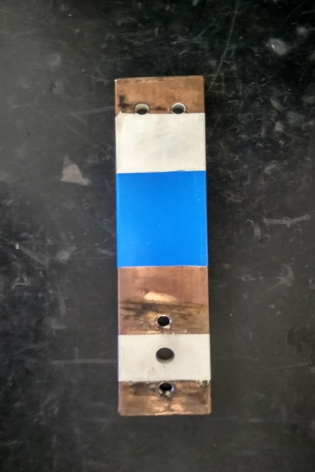
TOP TERMINAL(630A,1250A)
Input Current is given through Top Terminal which is connected to the vacuum interrupter
With respect to the quantity(amps) of current the dimensions of the copper terminal is decided.
Top terminal is made of copper for it’s high conductivity & resilience to higher temperatures, providing extra security during short circuit situations.

Slide 26
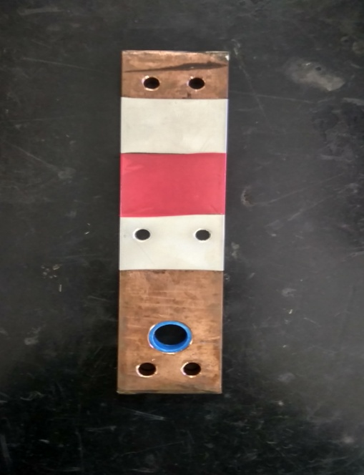
BOTTOM TERMINAL(1250A & 800A)
Output Current is given through Bottom Terminal which is connected to the vacuum interrupter
With respect to the quantity(amps) of current the dimensions of the copper terminal is decided.
Bottom terminal is made of copper for it’s high conductivity & resilience to higher temperatures, providing extra security during short circuit situations.

Slide 27
MATERIALS PROPERTIES | COPPER | ALUMINIUM
HARDNESS | 235–878 MPa | 160-350 MPa
RESISTANCE | 1.68×10⁻⁸ Ω.m | 2.65×10⁻⁸Ω.m
CORROSION | CORROSIVE (GALVANIC CORROSION) | LESS CORROSIVE
PROPERTY | DUCTILE | LESS DUCTILE
ELECTRICAL CONDUCTIVITY | 60.7 x 10⁶ S m⁻¹ | 37.7 x 10⁶ S m⁻¹
MELTING POINT | 1084.62 °C | 660.3°C

Slide 28
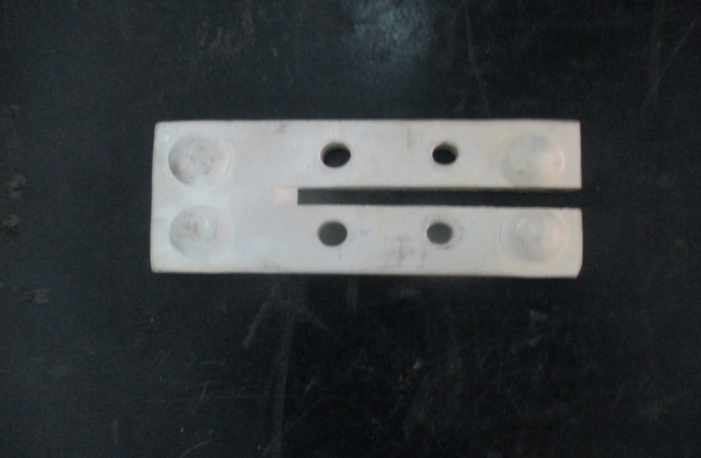
ISOLATING CONTACT
Isolating contact/finger clipping Top & Bottom terminal is used to conduct input current to the terminal via isolating contact.
It is made up copper coated with silver to improve thermal resistance and corrosion resistance
The rectangular cut is given to easily bend without twisting while tilting the breaker.

Slide 29
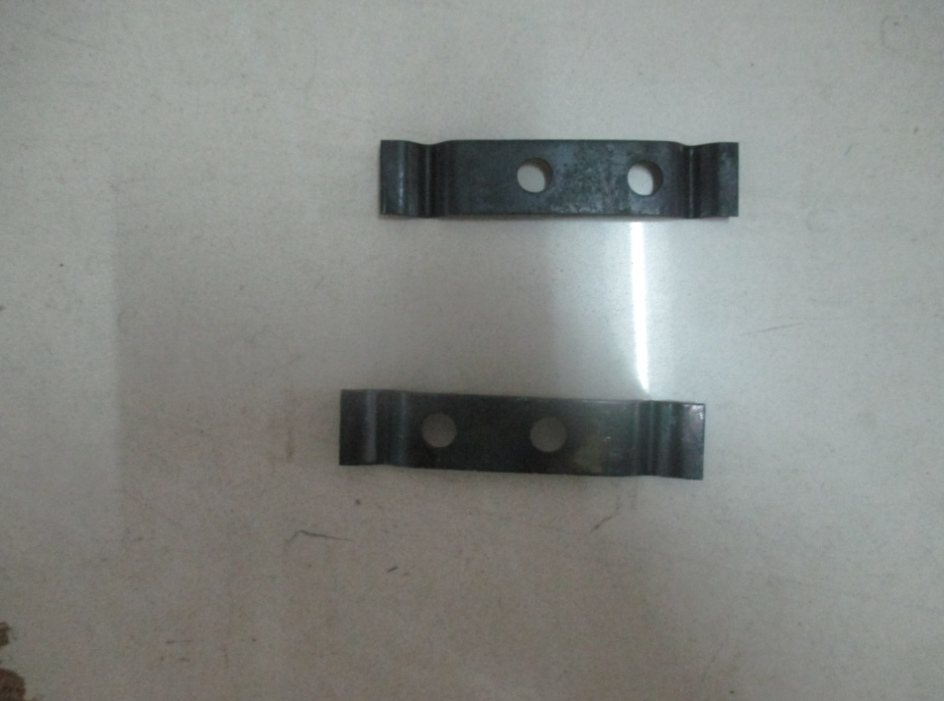
PRESSURE PLATE(1mm,2mm)
Pressure plate is used above isolating contact to hold with the screw for clipping action.
Spring steel is used because of high fatigue strength and formability.

Slide 30
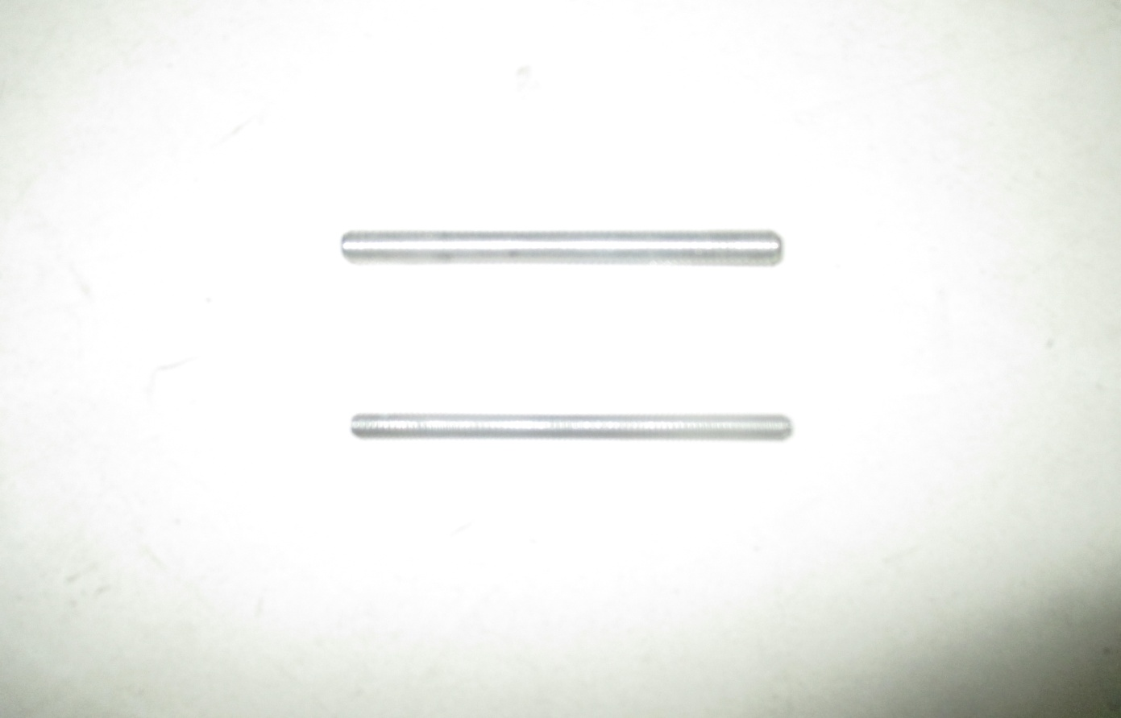
STUD FOR ISOLATING CONTACT(M6,M8)
Stud is used for combining isolating contact with terminal for locking purpose.
It is made up of steel as well as mild steel for reducing weight and increased strength.

Slide 31
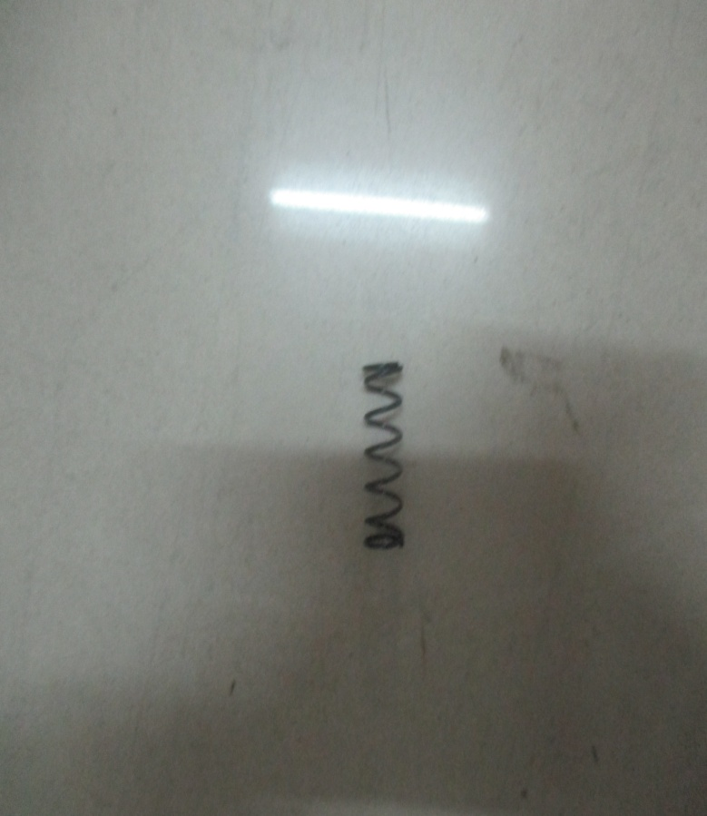
SELF ALIGN SPRING
Self aligning spring is used in isolating contact for clipping purpose to retain its initial position.
It is made of Mild steel having high modulus of elasticity and tensile strength

Slide 32
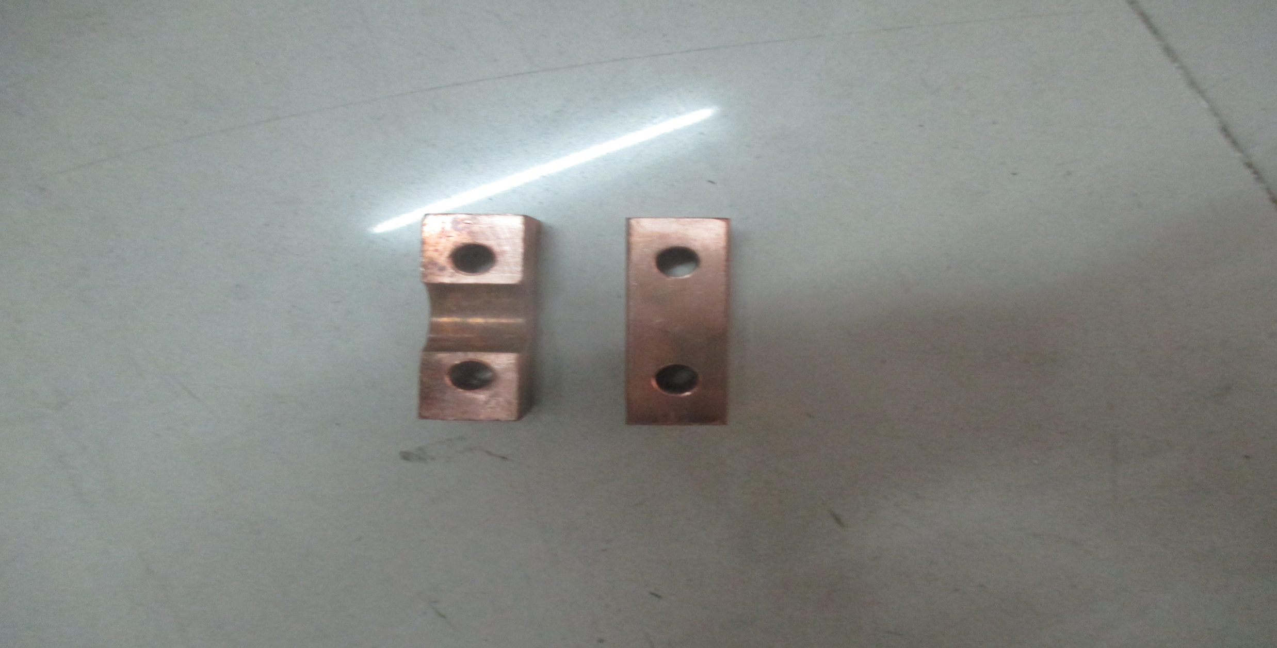
MOVING CONTACT BLOCK(800&1250A)
Moving contact block is used in bottom of vacuum interrupter for conducting current through copper flexible to Bottom terminal.
Ely. Copper is used for higher electricity conductivity.

Slide 33
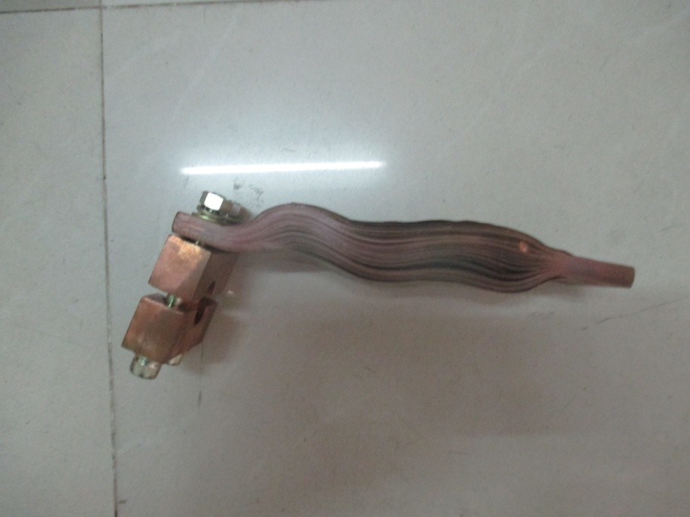
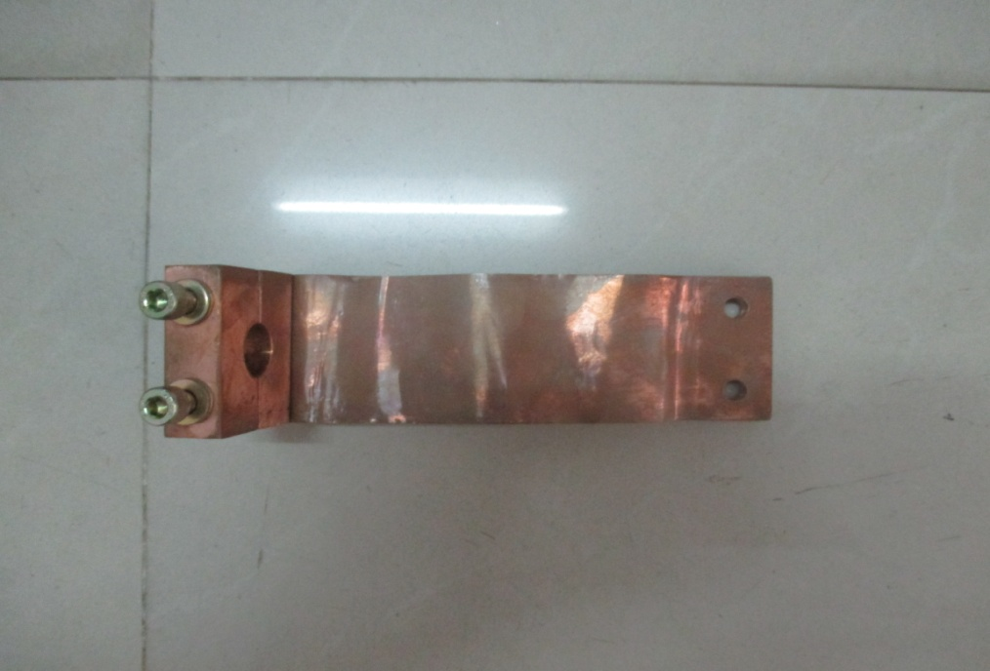
COPPER FLEXIBLE (1250A & 800A)
Copper flexible is used to conduct electricity from Moving Contact Block to the Bottom terminal.
It is made of number of strips together to made flexible for required movement.

Slide 34

DRIVE ROD FOR POLE
Drive rod is used to drive the bottom interrupter for opening and closing by the action of spring charging mechanism.
It is made up of Mild steel because it has great strength to withstand sudden impact load.

Slide 35
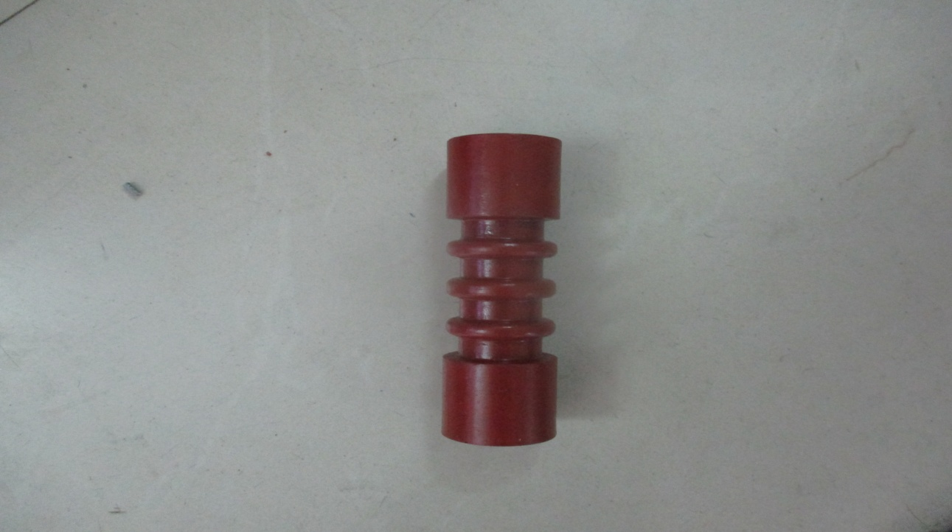
INSULATOR FOR DRIVE ROD
Drive rod is inserted in the insulator for insulation from the Bottom terminal.
It is made up of epoxy because of high heat resisting and electrical insulating properties.

Slide 36
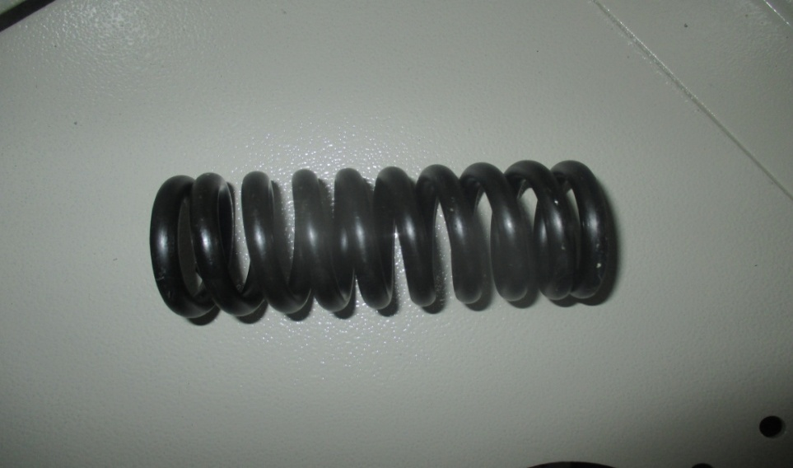
OUTER CLOSING SPRING
Outer closing spring is the main spring which is used to store charge for closing purpose.
It is an open coil spring which is compressed for storing the charge.
It is made of spring steel which is processed via heat or mechanical treatment to have a high yield stress. This allows it to undergo deflection without permanent deformation.

Slide 37
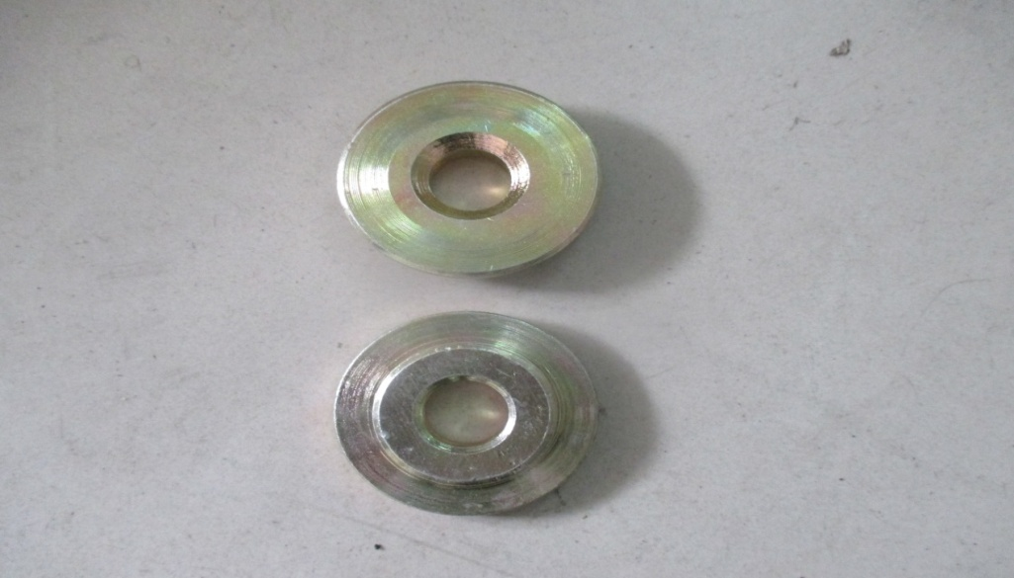
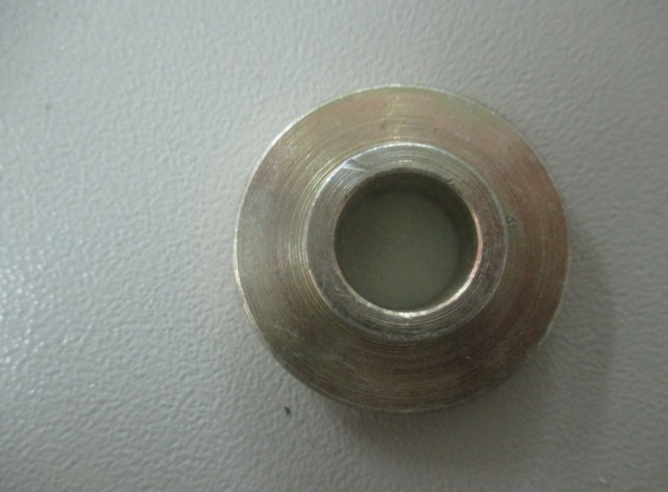
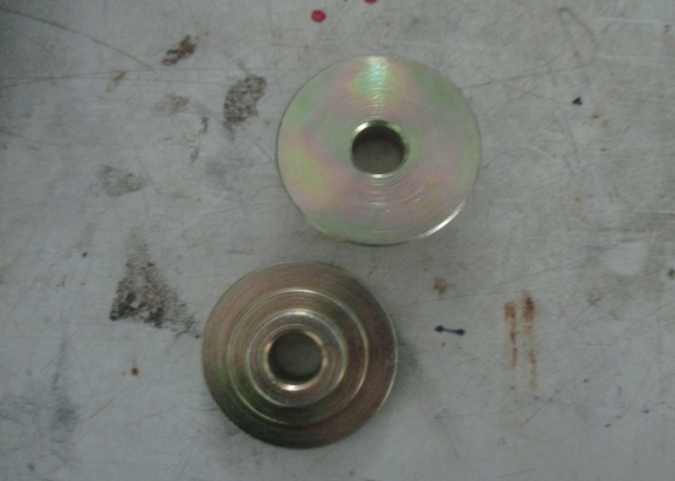
LOCATING WASHER FOR CLOSING SPRING & CONTACT SPRING
FOR CLOSING SPRING
FOR HOLD OPEN SPRING
FOR CLOSING SPRING
Locating washer is used in closing spring assembly to hold the spring and the main rod, as swivel block and rod end bearing & to hold the swivel block.
It is made up of Mild steel because it has great strength to withstand sudden impact load.

Slide 38
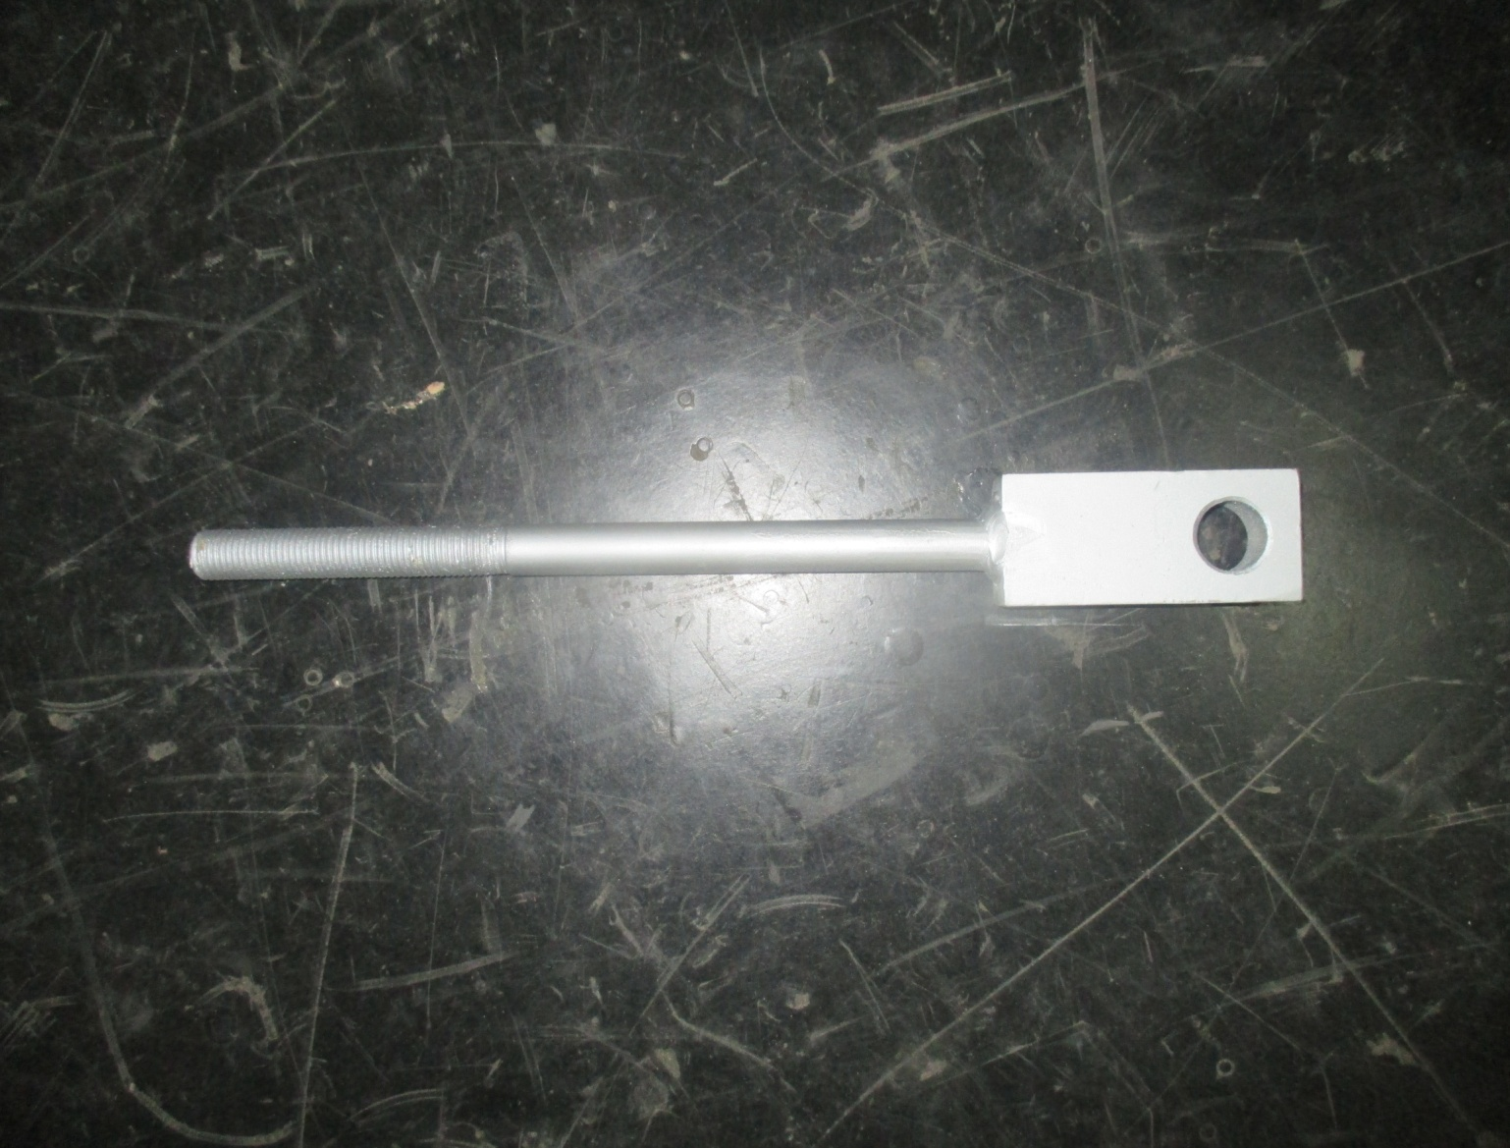
WA OF GUIDE ROD
Guide rod is used to compress the spring as well as for guiding the closing spring.
It is made up of Mild steel because it has great strength to withstand sudden impact load.

Slide 39
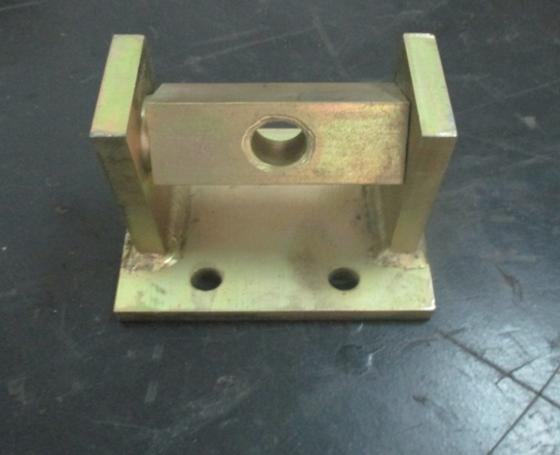
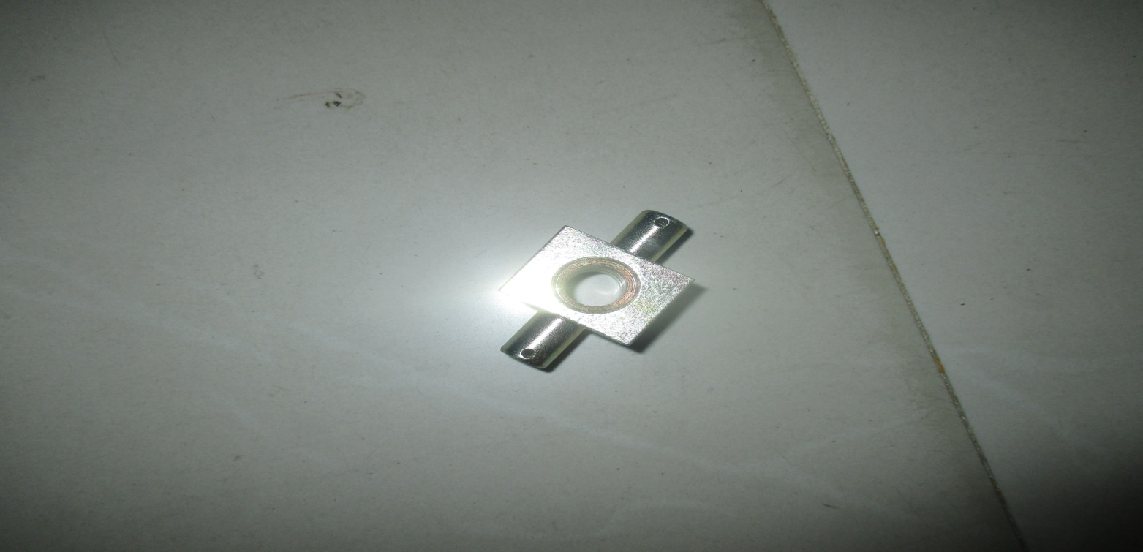
WA OF SWIVEL BLOCK FOR CLOSING SPRING & BELL CRANK
Closing spring Swivel bock is used in upper part of closing spring assembly to swivel the guide rod along with it.
Bell Swivel block swivels with the hold open spring assembly to give appropriate movement to the bell crank.
It is made up of Mild steel because it has great strength to withstand sudden impact load.

Slide 40
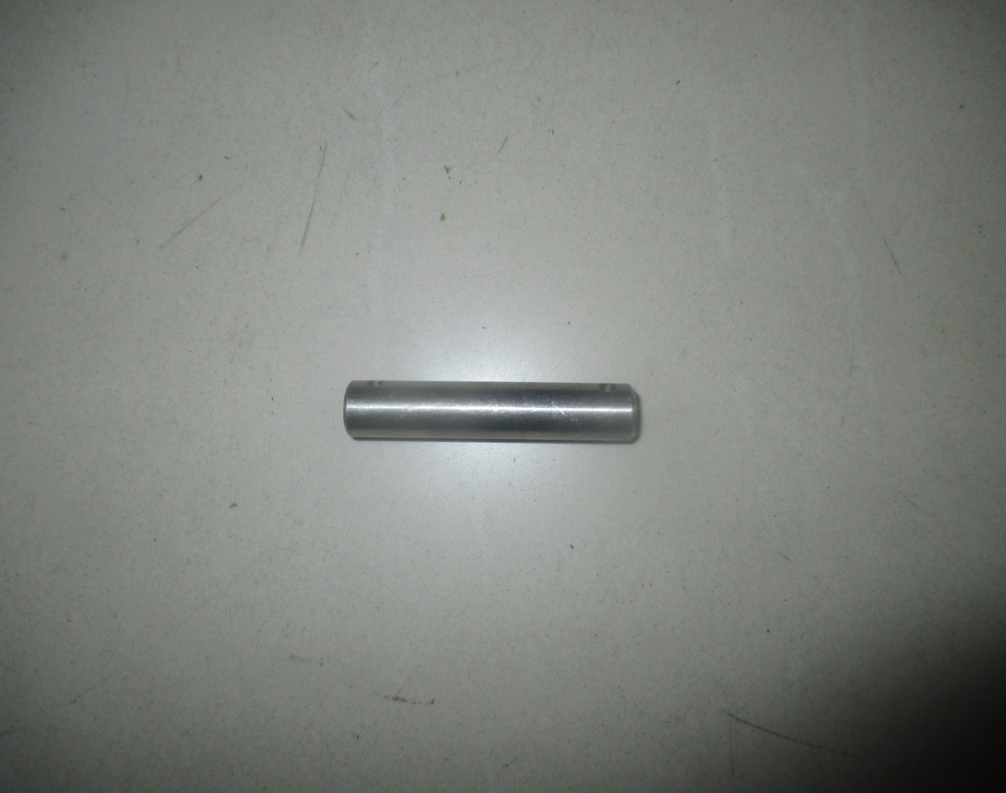

SS PIN FOR ROD END BEARING & BELL CRANK
SS PIN FOR ROD END BEARING
SS PIN FOR BELL CRANK
REB Pin is used to connect rod end bearing with bell crank.
BC Pin is used to connect bell crank with the attachment for holding.
It made up of Stainless Steel (SS) which has high ductility hence wear is reduced.

Slide 41
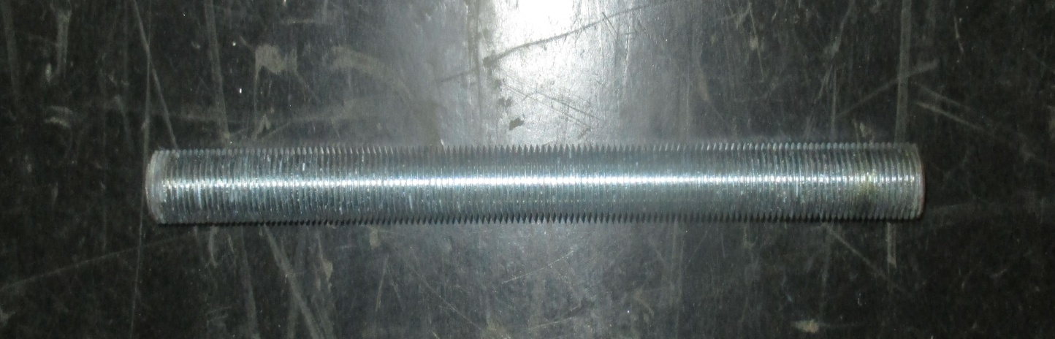
STUD FOR CONTACT SPRING
Stud is used to guide the spring and also to transfer the spring force to the bell crank.
It is made up of steel as well as mild steel for reducing weight and increased strength.

Slide 42
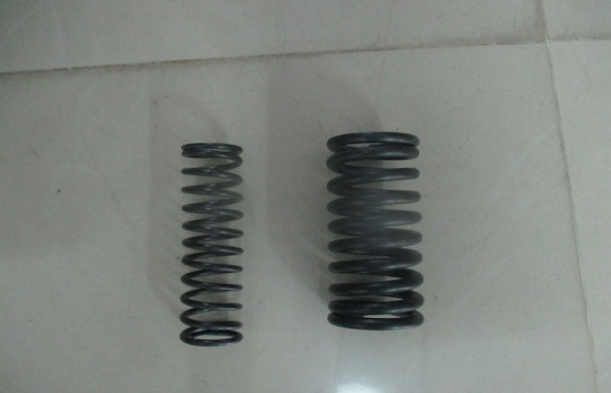
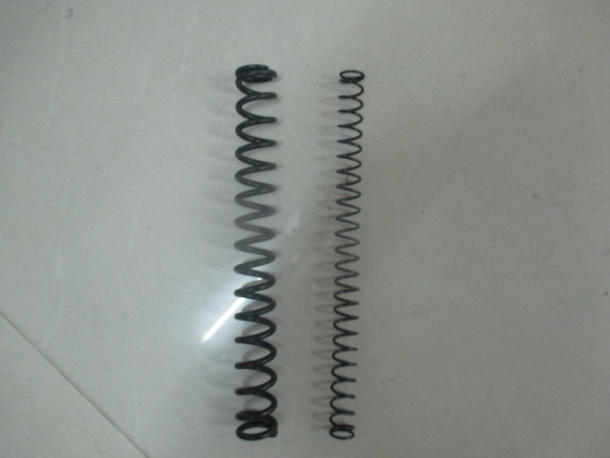
CONTACT SPRING & HOLD OPEN SPRING (INNER & OUTER)
Inner & Outer contact spring is the spring which is used to store charge. Open spring is the spring which is used to store charge for opening purpose.
It is an open coil spring which is compressed for storing the charge.
It is made of spring steel which is processed via heat and mechanical treatment to have a high yield stress. This allows it to undergo deflection without permanent deformation.

Slide 43
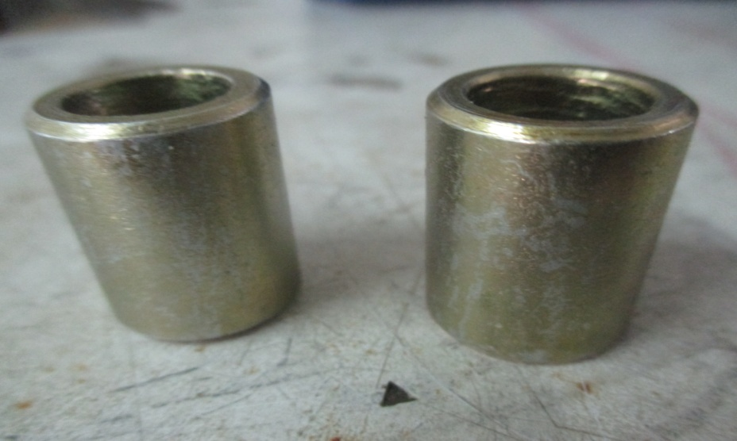
SPACER FOR BEL CRANK
Spacer is used to provide space in between the welding assembly of closing spring guide rod and the mechanism.
In the absence of spacer it may lead to dislocate the guide rod of closing spring.

Slide 44
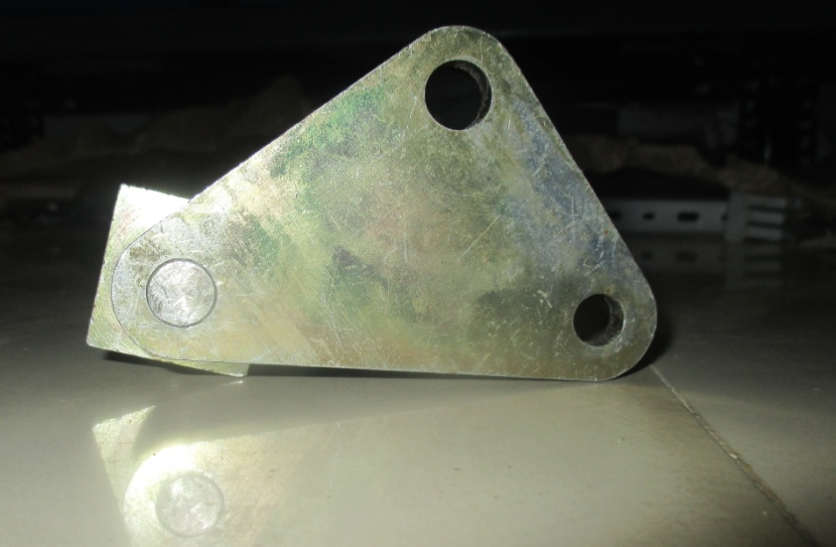
BEL CRANK
NORMAL FORCE
FIXED POINT
NORMAL FORCE
A bell crank is a type of crank that changes motion through an angle. It has a lever with two arms which have a common fulcrum(fixed point) at their junction.
It is used to drive the vacuum interrupter by the movement of opening spring assembly from 0° to 90°.

Slide 45
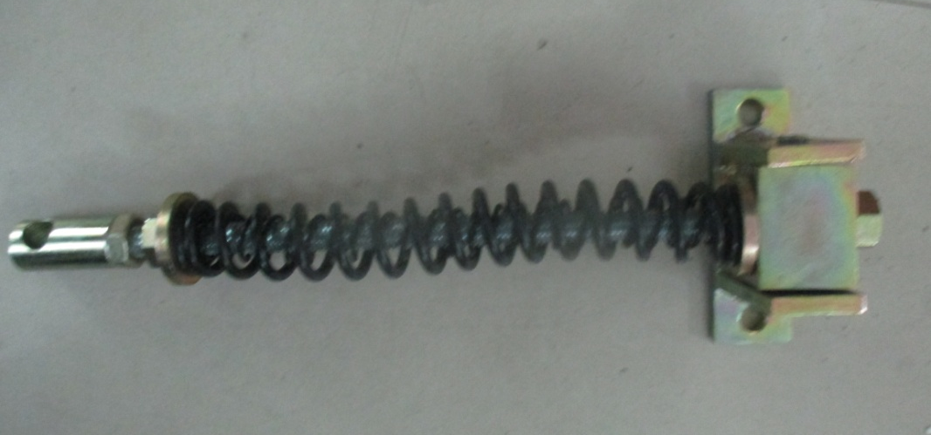
SWIVEL BLOCK ASSEMBLY FOR HOLD OPEN SPRING & STUD FOR OPEN SPRING
STUD
Swivel block swivels with the hold open spring assembly to give appropriate movement. Without this may lead to dislocate of the stud.
Stud is used to guide the spring and also to transfer the spring force to the bell crank.
It is made up of Mild steel because it has great strength to withstand sudden impact load.

Slide 46
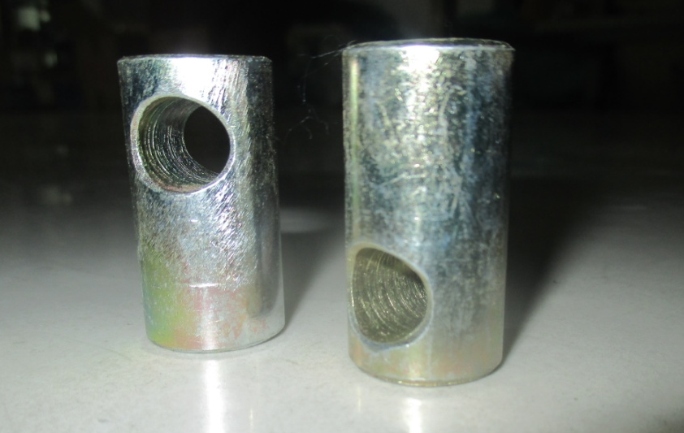
ADOPTER BLOCK FOR SPRING GUIDE
Adopter block is used in top of the contact spring assembly to force the stud for closing spring.
It is made up of Mild steel because it has great strength to withstand sudden impact load.

Slide 47
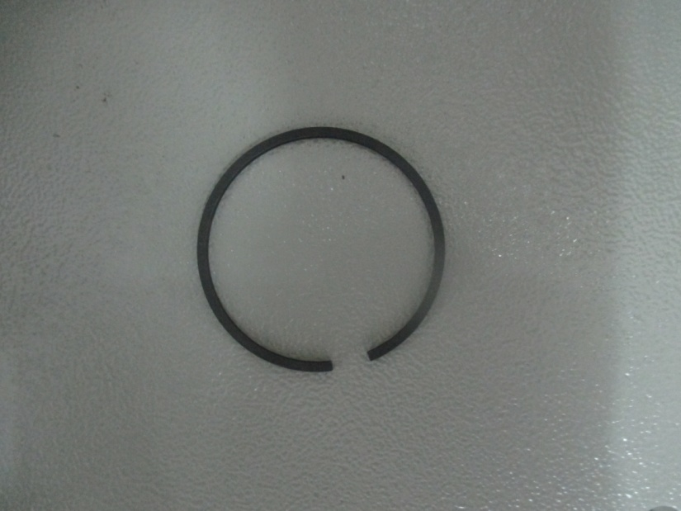
PISTON RING
Piston ring used in dashpot is used to block the leakage of air inside the cylinder.
It is fitted in the piston groove to seal with the cylinder.
Piston rings are subject to wear as they move up and down the cylinder bore due to load and due to the air load acting on the ring. To minimize this, they are made of wear-resistant materials, such as cast iron.

Slide 48
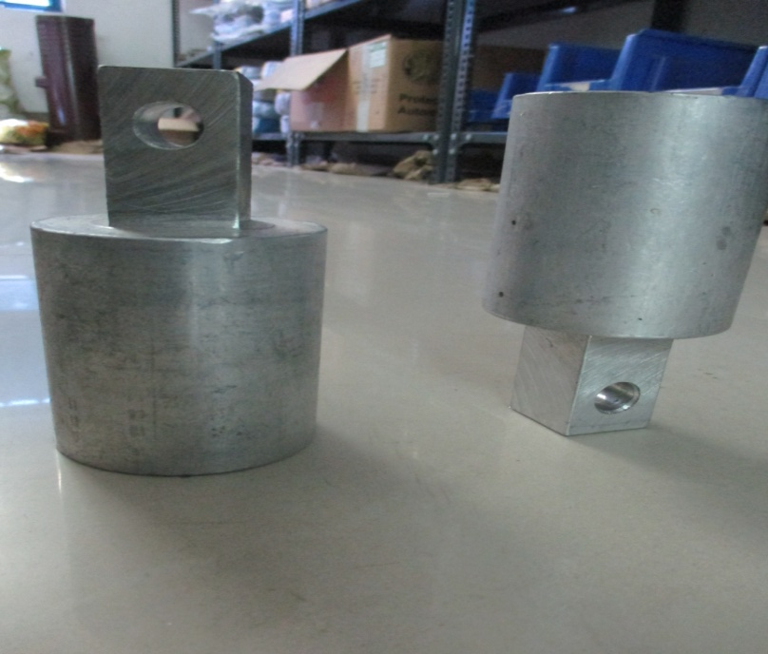
DASHPOT
Air Dashpots are used when there is the need to reduce or eliminate harmful or excessive motion by damping the vibrations and shocks.
Aluminium made due to light weight and corrosion resistance.

Slide 49
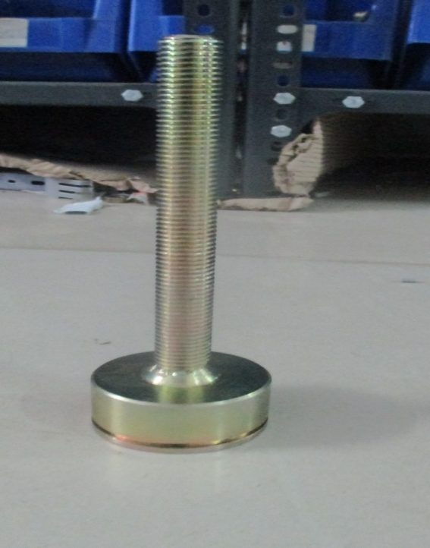
WA OF PISTON FOR DASH POT
Piston is used to compress the air inside the cylinder and also to resist the motion as well.
It is made up of Mild steel because it has great strength and wear resistance.

Slide 50
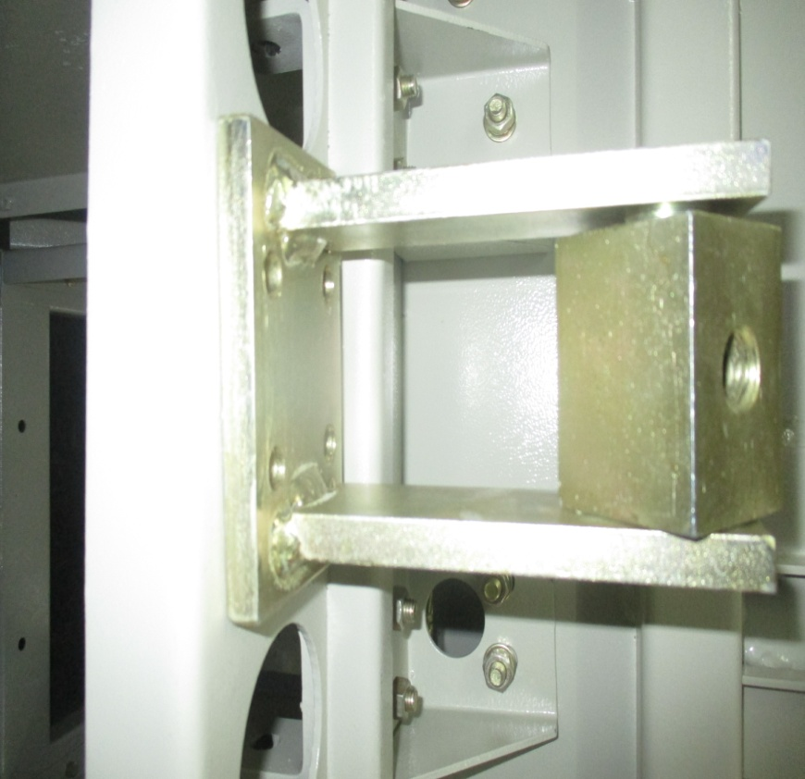
WA SWIVEL BLOCK FOR DASHPOT
Swivel block swivels with the piston to give appropriate movement to the dashpot.
It is made up of Mild steel because it has great strength to withstand sudden impact load.

Slide 51
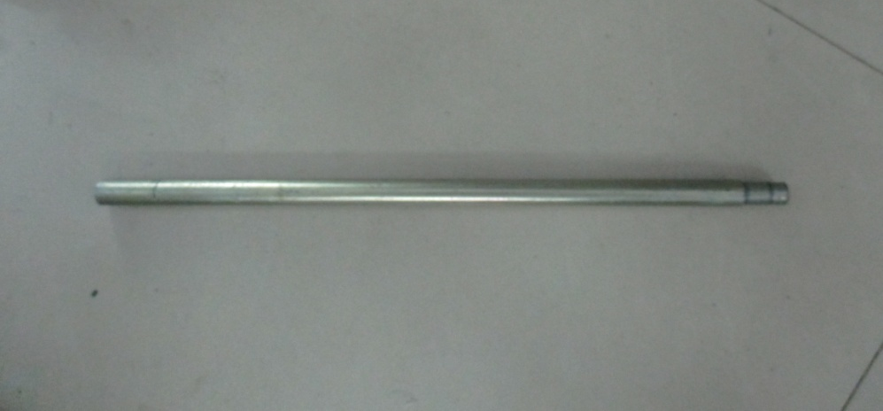
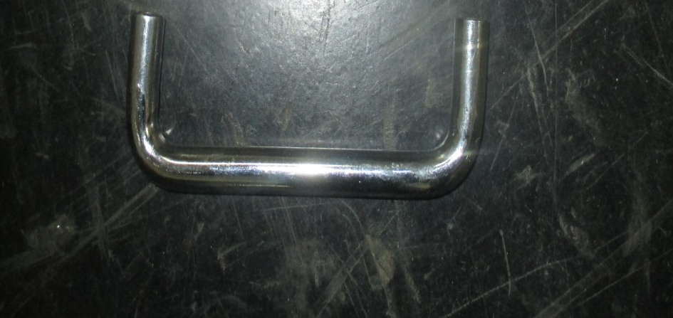
CHARGING HANDLE & DOOR HANDLE
Charging handle is used to crank the ratchet mechanism to charge the closing spring. It is the manual type of charging the closing spring.
Door handle is used to open and close the door of the breaker.
It is made up of Mild steel because it has great strength and hardness.

Slide 52
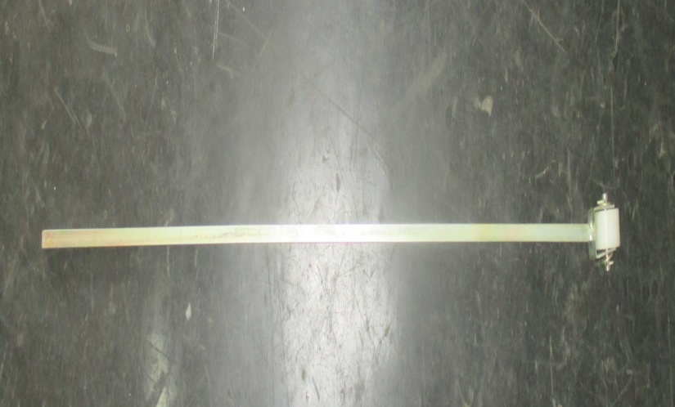
TRIPPING INTERLOCK ROD
Tripping interlock is a safety tripping rod. When the breaker is brought to test or service position it must trip for safety concern.
It is made up of Mild steel because it has great strength and hardness.

Slide 53
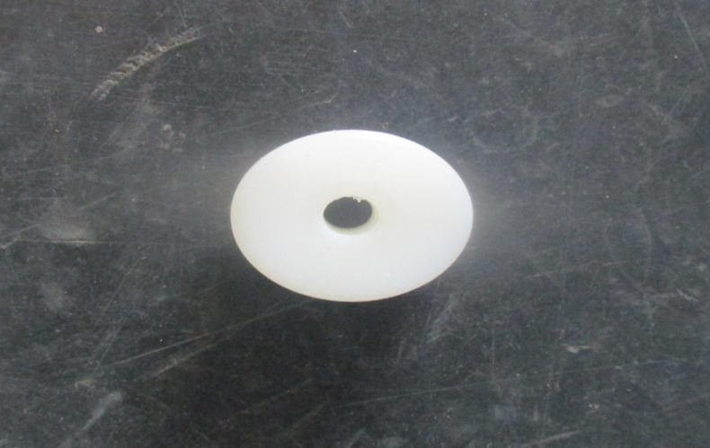
TRIPPING INTERLOCK,TRUCK & SHUTTER WHEEL
Interlock tripping is achieved through this wheel. This wheel is provided to match the breaker movement.
Truck wheel is provided to transport the breaker easily.
Shutter wheel is provided for guiding the shutter square rod for opening and closing the SMC shutter.
It is made by nylon for:
Low Wear and Extremely Abrasion Resistant.
Low Roll Resistance, Can Carry Heavy Loads.

Slide 54
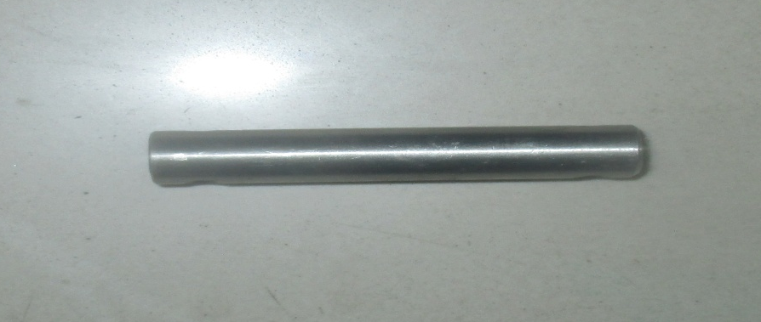
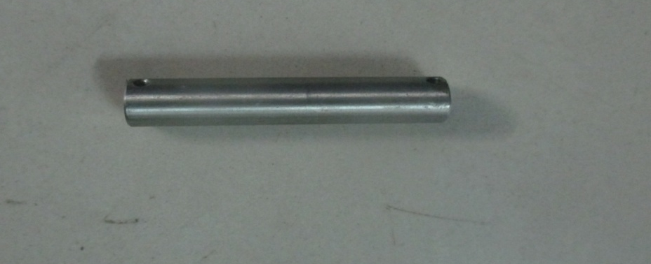
SS PIN FOR TRIPPING INTERLOCK & TRUCK WHEEL
FOR TRIPPING INTERLOCK
FOR TRUCK WHEEL
This Pin is used to connect tripping interlock rod with nylon wheel.
This Pin is used to connect truck wheel with shutter rod.
It made up of Stainless Steel (SS) which has high ductility hence wear is reduced.

Slide 55
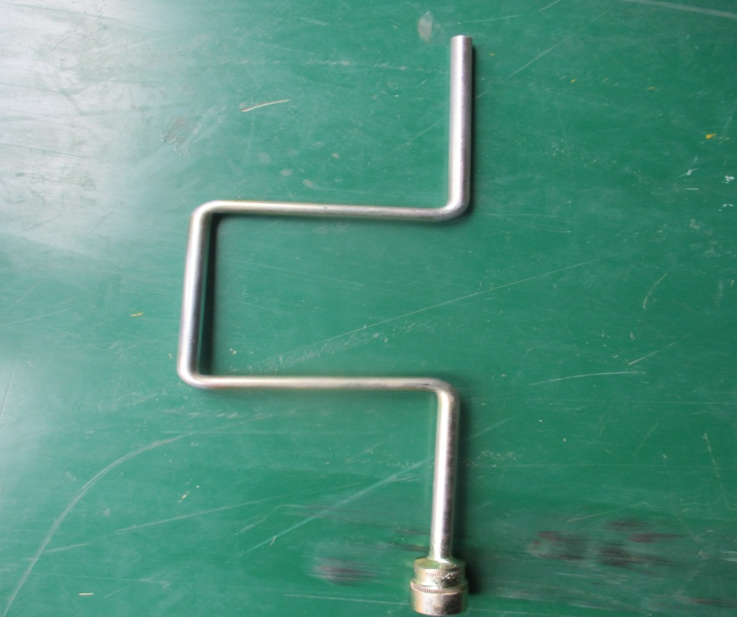
WA OF RACK IN/OUT HANDLE
Rack in/out handle is used to drive the screw rod to rack the whole breaker into the compartment.
This handle is bended in the middle to increase the screwing torque for easy work.

Slide 56
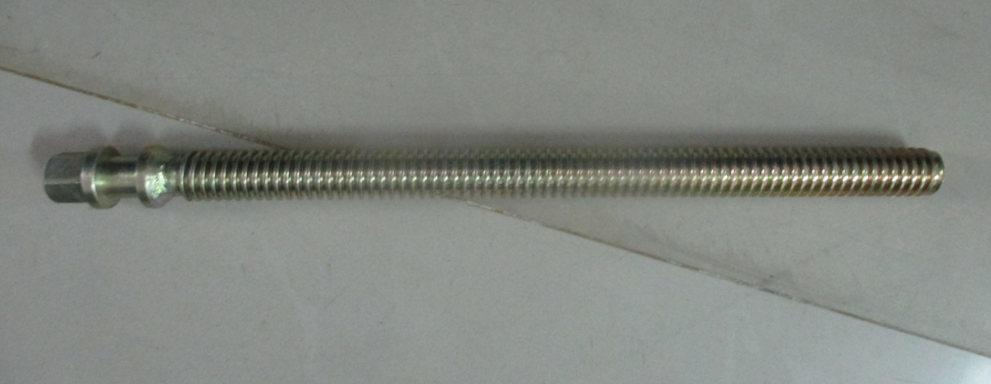
SCREW ROD
Screw rod is used to drive the whole breaker to rack into the breaker compartment.
This screw has thread for movement of the breaker with the nut block.

Slide 57
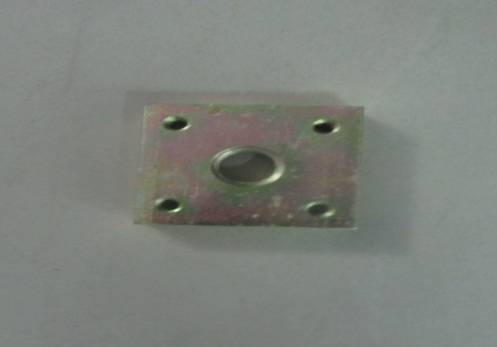
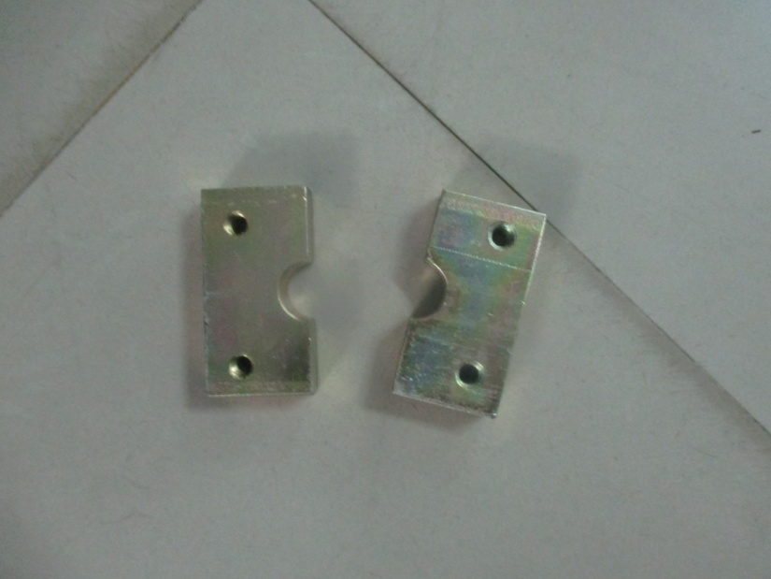
NUT BLOCK & HINGE BLOCK FOR SCREW ROD
NUT BLOCK
HINGE BLOCK
Nut block is fixed attachment wherein screw rod drives in to rack the breaker.
Hinge block is used to support the screw rod and to provide the guide way to the screw rod.
It is made up of Mild steel because it has great strength to withstand sudden impact load.

Slide 58
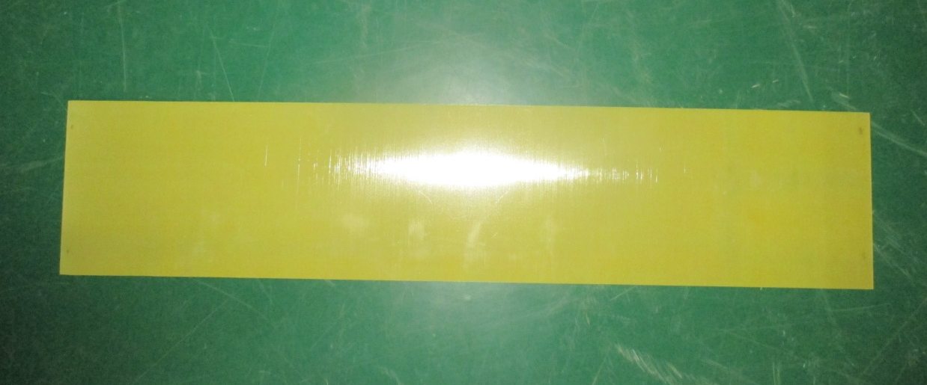
SMC SHUTTER
Sheet Moulding Compound Shutter is provided to open and close the incoming and outgoing side from the panel while rack in/out the breaker.
It is made of Fibre glass Reinforced Plastic for weightless insulation properties.

Slide 59
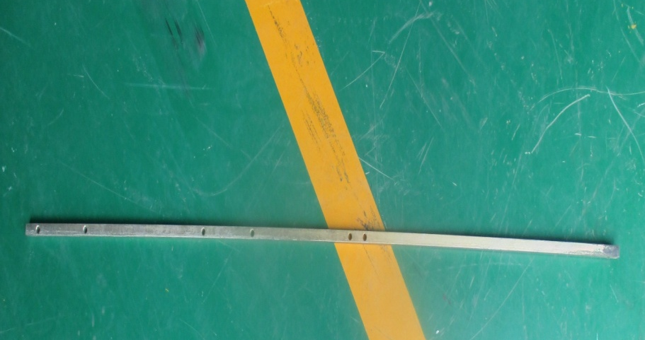

SHUTTER SQUARE ROD & RISING LEVER
SHUTTER SQUARE ROD
RISING LEVER
Shutter square rod is used in the operation of opening and closing of shutter while racking in & out of the breaker.
The rising lever is used to lift the shutter up and down automatically .

Slide 60

CLOSING COIL & TRIP COIL
Trip coil is a solenoid coil which is connected to a sensitive circuit that designed to disconnect power line.
Closing circuit coil is one that connected to a circuit that ensures the power conditions are normal this coil acts to establish broken circuit.

Slide 61


PLUNGER & CLOSING FOR L BRACKET
PLUNGER
CLOSING
Push button provided as a L bracket has a plunger to push the closing and opening coil with aligning spring to bring back to the original position.
Closing for L bracket assembles with the plunger and align spring to provide necessary push button for opening and closing coils.

Slide 62

LIMIT SWITCH FOR SPRING CHARGE MOTOR
A limit switch is an electro-mechanical device that consists of an actuator mechanically linked to a set of contacts. When an object comes into contact with the actuator, the device operates the contacts to make or break an electrical connection.
It is used for spring charge motor by setting a limit to charge the spring.

Slide 63


AUXILARY SWITCH & AUX.SWITCH LEVER
An auxiliary switch is a single-pole, double-throw switch operated by the movable contact arm assembly. It is used to remotely indicate the position of the main circuit breaker contacts, whether open or closed. Auxiliary switches can be used to operate indicator lights, relays or other accessories.
Auxiliary switch lever is used to lock the auxiliary switch with the socket.
It is made of nylon for high abrasion resistance.

Slide 64

SPRING CHARGE MOTOR
A spring charge motor is used to crank the ratchet mechanism to charge the closing spring. It is the automatic type of charging the closing spring.

Slide 65

WIRE
A wire is a single, usually cylindrical, flexible strand or rod of metal.
Wires are used to bear electricity. Wire is commonly formed by drawing the metal through a hole in a die or draw plate.
It is usually covered with insulator such as plastic.

Slide 66

LUGS
Electrical lugs are used when permanent connection is not possible between devices or cables.
Use of cable lugs allows in easy installation, repair and maintenance of electrical devices or cables.

Slide 67



BOLT NUT WITH WASHERS -1
Bolt is a mechanical fastener that is usually used with a nut for connecting two or more parts. A bolted joint can be readily disassembled and reassembled.
Washer is used to distribute the load on the bolt evenly to the surfaces.

Slide 68



BOLT NUTS WITH WASHERS -2
Bolt has outer thread and nut has inner threads to make a screw function and thereby locking it. Washer is also used to neglect the slipping of the bolt while tightening or loosening the nut.

Slide 69


PLUG & SOCKET
Plug from the switchgear panel is connected to the breaker via socket for sending and receiving the signals.

Slide 70

TERMINAL BLOCK
Terminal block is used to loop the wire and to eliminate the wire joint.
Multiple terminal blocks mounted on the rail to provide hassle free wire connections.

Slide 71


TRUFF WITH RAIL
Truff is used to make the wire in a group manner for hassle free wire connections.
Rail is used to mount the terminal blocks and various equipments.

Slide 72

GROUP MARKER
Group markers are used to identify an assembly of adjacent terminals that are associated with a specific function, control circuit, or part of a machine.

Slide 73


END PLATE & END CLAMP
END PLATE
END CLAMP
These end plates are used to cover the end clamp mounted on rail.
End clamps also known as End Stoppers are used to hold a stack of terminal blocks on the mounting rail.

Slide 74

COUNTER
Counter is used to count the number of tripping operation done.
It is made up of Fibre reinforced plastic composite material for precision counting.

Slide 75


NYLON LOCK NUTS -1 & 2
Nylon lock nut is a kind of locknut with a nylon collar insert that resists turning.

Slide 76


WASHERS -1 & 2
Washer is used to distribute the load on the bolt evenly to the surfaces.
Washer is also used to neglect the slipping of the bolt while tightening or loosening the nut.

Slide 77
Types of Washers:
Plain Washer
Spring Washer
Fender Washer
Penny Washer
Spherical Washer
Torque Washer
Wave Washer
Belleville Washer
Curved disc Washer
Split Washer
PLAIN WASHER | SPRING WASHER
Plain washer spreads a load and prevent damage to the surface. Plain washers can also be used when the hole is bigger than the nut. | Spring washer have axial flexibility and are used to prevent fastening loosening due to vibrations They are typically used in machines and equipment that create strong vibrations.

Slide 78


HEX NUTS & HALF NUTS
Hex nut is nothing but a normal nut but with six faces. hexagonal fastener with internal threads that screws on to the shank of a bolt or a hex cap screw.
A screw nut split lengthwise so that either one part may be arranged to ride on a screw or the two parts may be arranged to clamp about a screw.

Slide 79


BRASS WASHERS -1 & 2
Washers made from brass are often used for applications where low friction is required.

Slide 80

HELICOIL
A Helicoil is a coiled-wire type of thread repair insert used to create internal screw threads to accommodate standard-sized fasteners.

Slide 81


ALLEN BOLT & HEX BOLT -1
Allen bolt is a bolt with a hexagonal socket in its head that is designed to be used with an Allen wrench.
Hex bolts with forged heads are also commonly used as headed anchor bolts.

Slide 82
SIZE(MX) | GRADE
4MM | 4.4 GRADE M.S PLATED
5MM | AS ABOVE
6MM | AS ABOVE
8 & ABOVE | HT 8.8 GRADE M.S PLATED
The first digit relates to the ultimate strength of the material, while the second is the ratio of yield stress to ultimate strength.
Thus grade 4.4 bolts have an ultimate material strength of 400N/mm² and the yield stress is 40% of the ultimate strength.
It has Zinc yellow coating to resist corrosion.

Slide 83

MECHANISM
It is the spring charge mechanism for vacuum circuit breaker. It has a mechanism to charge the coil and to trip the breaker.

Slide 84


Al. PUSH BUTTON & MS PUSH BUTON WITH M.S HOLLOW BUSH
AL. PUSH BUTTON
M.S PUSH BUTTON
Aluminium push buttons are used in the breaker outdoor panel which is connected with trip and closing coil for easy operation.
M.S push button assembly allows you to trip and close the coil easily with this push button. It has a self align spring to bring back the initial position.

